Slide 1
TDD Workshop
Hands-on Project

Slide 2
Introduction to the Project

Slide 3

Welcome to “Sheeper”!
We are a scrappy startup that is totally not a Twitter knockoff. Our mission is to deliver the most innovative social network ever! Its gonna be huge.

Slide 4
Agenda
Learning about the state of the art Sheeper architecture and UX.
Implement the delete feature together
Break out into two-person teams, fix a defect, and implement another feature – edit.

Slide 5
The Sheeper Site
Our website allows people to post short messages “bleets” ( bleats are the sound sheep make, but we spell it c0013r).
There is a SPA built with AngularJS that communicates with a backend written in NodeJS and Express.
The backend contains two micro services:
Bleet Service – Used to post, delete, edit, bleets.
User Service – Used to create, edit, delete users.
More info on the API can be found here: https://github.com/francesco-desensi/tdd-workshop-angular-js/wiki/Sheeper-Api

Slide 6
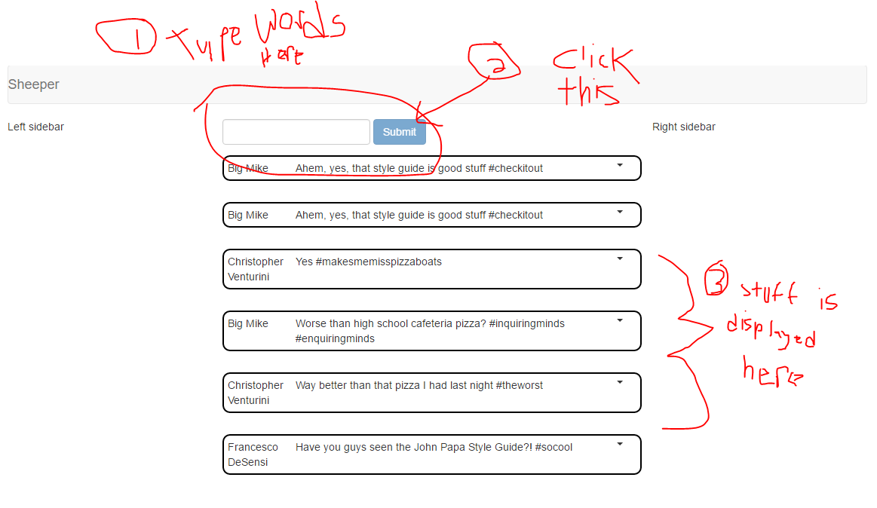
How it Works (The Magic)

Slide 7
Group Feature Implementation
Delete a Bleet

Slide 8
Getting started…
We need to add the ability to delete a bleet.
Let’s start by adding a delete function to the bleet service.
We will do this by first creating a test in app\data\bleets.spec.js

Slide 9
Red/Green/Refactor
We will start by making a failing test (red) that checks to see if the “deleteBleet” function calls the right endpoint.
We will use $httpBackend to help us do this.
You can then run the test suite by running the command “gulp test”

Slide 10
Red/Green/Refactor
Make the test pass.

Slide 11
Red/Green/Refactor
You can now safely change the code. Look for code smells or other improvements and repeat the cycle until finished.

Slide 12
Next steps…
Consider various inputs and error conditions. Add additional tests.
Implement the “deletePost” method in /app/posts/post.directive.js
Add an ng-click hanlder in the post view.
Add an event handler to the feed

Slide 13
Breakout

Slide 14
Your mission…
As a sheeper
I want the ability edit bleets
So that I can change the texts of bleets when I make mistakes and stuff.

Slide 15
Also…
There is a bug…find it…fix it using TDD practices.
Ask for guidance if you are not sure how to approach it.

Slide 16
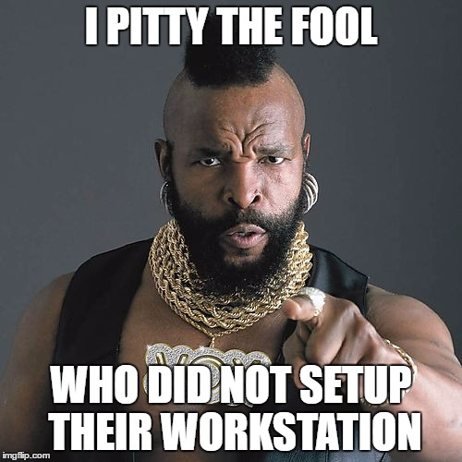
Workstation Setup
https://github.com/francesco-desensi/tdd-workshop-angular-js/wiki/workspace-setup

Slide 17

Get a partner

Slide 18
During the exercise…
Please try to practice the following TDD principles…
Always start with a test
Arrange
Act
Assert
Red/Green/Refactor
Make the test fail
Write the code
Make the test pass
Refactor
Repeat

